Slide 1

SMART INDIA HACKATHON 2026
TITLE PAGE
Problem Statement ID –SIH26003
Problem Statement Title- AI-Based Cognitive Gaming and Memory Assistance Platform for Elderly Dementia Patients in North Eastern Region (NER)
Theme- MedTech / BioTech / HealthTech
PS Category- Software
Team ID- 1
Team Name (Registered on portal)- Sidequest

Slide 2
IDEA TITLE
SideQuest
Personalized Cognitive Care & Engagement Platform for Dementia Patients
SAHARA is a dementia-support application with two separate interfaces: Patient and Caretaker.
Patient interface provides three cognitive games: Memory Match, Sequence Recall, and Family Recognition.
Caretaker dashboard enables activity, scores, schedules, medicine-status tracking, and family-photo management.
Includes voice-assisted instructions and language support for improved accessibility.
Provides simple and engaging cognitive activities for elderly users. Uses familiar family photos to make recognition activities personalized. Helps caregivers monitor activity and performance from one dashboard.
Combines cognitive gaming + personalized family recognition + caregiver monitoring in one platform. Randomized game
content provides variety instead of repeating identical sessions. Voice and multilingual support improves accessibility for
elderly users.

Slide 3
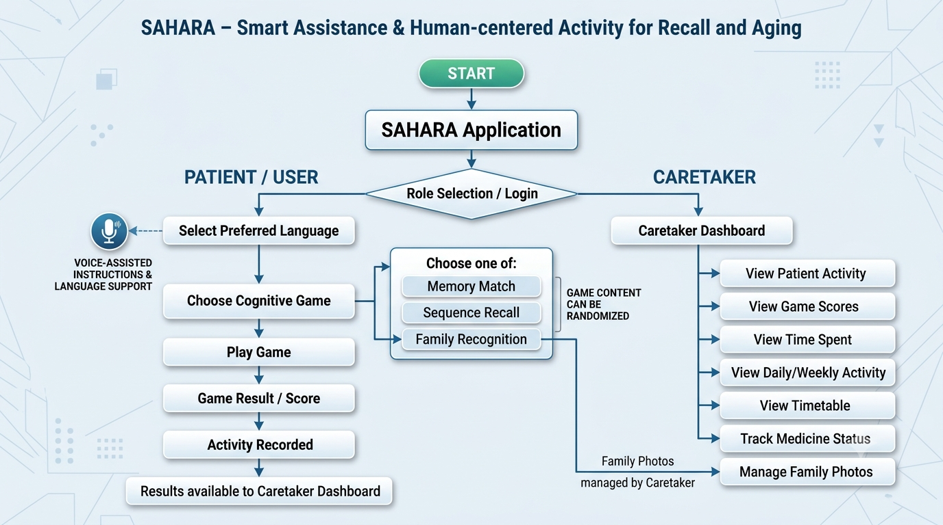
TECHNICAL APPROACH
SideQuest
Process Flowchart
Technologies used
React + Vite→ Frontend Local Storage / Database → Data Speech Technology → Voice Role-Based Authentication → Security

Slide 4
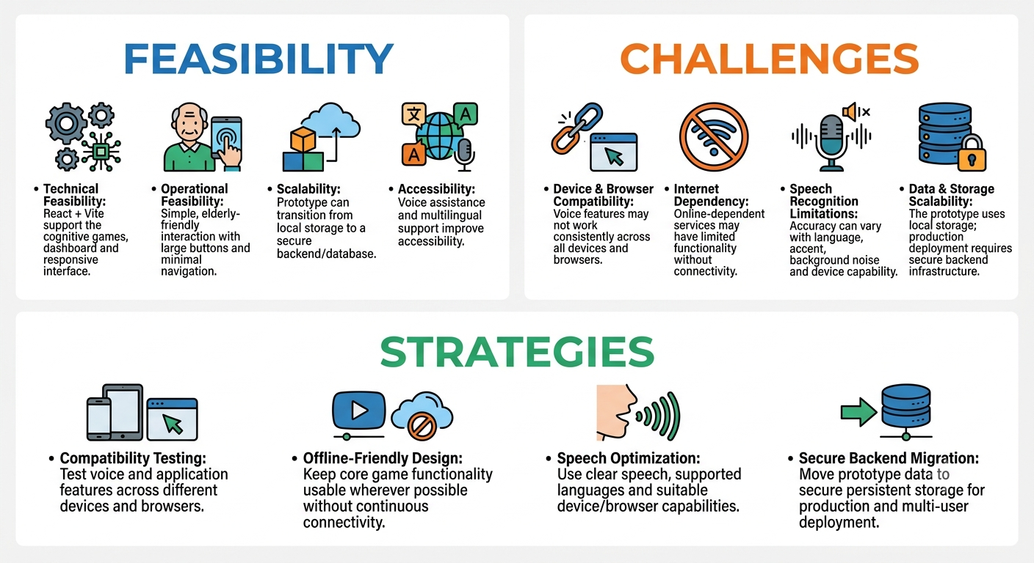
FEASIBILITY AND VIABILITY
SideQuest

Slide 5
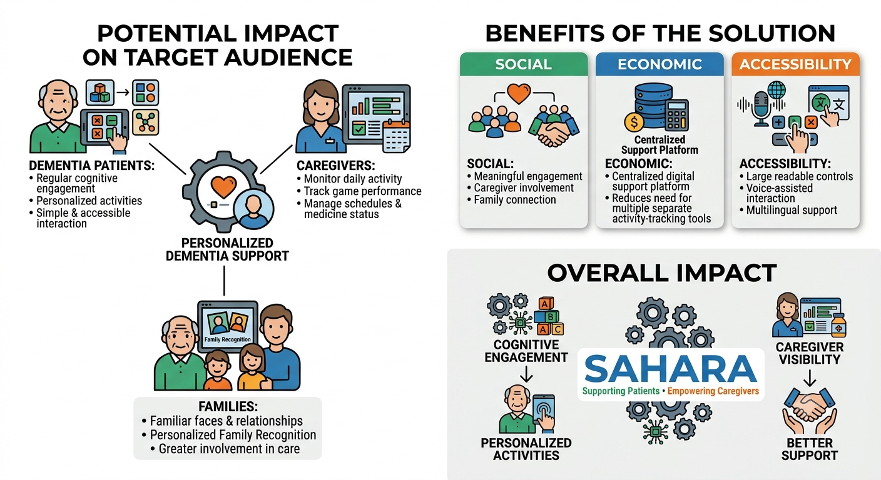
IMPACT AND BENEFITS
SideQuest

Slide 6
RESEARCH AND REFERENCES
SideQuest
Details / Links of the reference and research work
Effectiveness of Internet-Based or Mobile App Interventions for Family Caregivers of Older Adults with Dementia: A Systematic Review – PubMed : Internet and mobile-based interventions can improve the well-being and support needs of dementia caregivers.
Home-Based Digital Healthcare Interventions for Dementia: A Systematic Review of Patient and Family Caregiver Outcomes - PubMed :Digital, personalized, home-based interventions can support cognitive health in dementia while reducing caregiver burden and stress.

